Slide 1

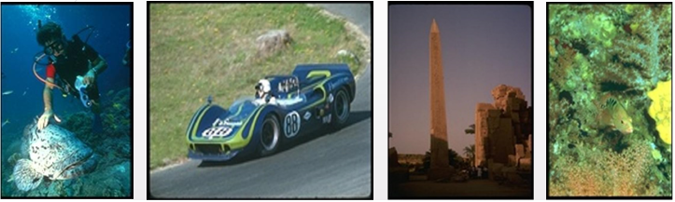
2017 Artificial Intelligence and Signal Processing Conference (AISP)
Leveraging Deep Learning Representation for Search-based Image Annotation
Authors : Mahya Mohammadi Kashani, S. Hamid Amiri
Department of Computer Engineering
Shahid Rajaee Teacher Training University

Slide 2

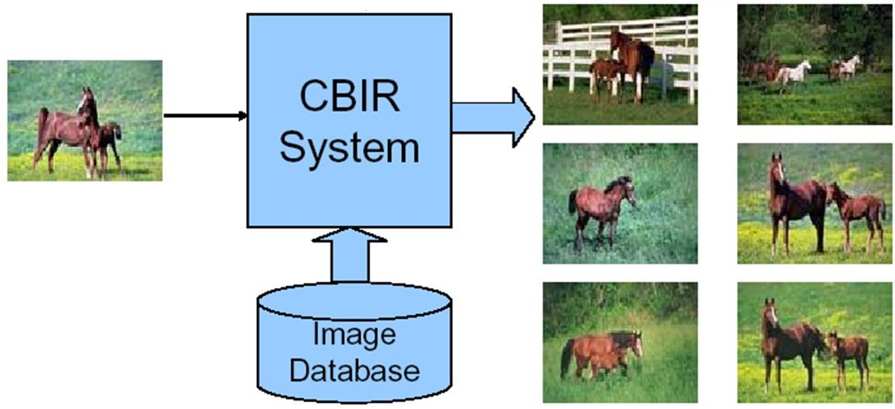
Introduction
2017 Artificial Intelligence and Signal Processing Conference (AISP)
Introduction
AIA approaches
Conclusion
References
Proposed Method
Experiments
Images Retrieval

Slide 3

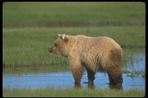
Introduction
2017 Artificial Intelligence and Signal Processing Conference (AISP)
Introduction
AIA approaches
Conclusion
References
Proposed Method
Experiments
Input Image
Automatic Image Annotation
Output Image
Feature Extraction
Tag Assignment
Tags: Bear, River, water, grass, Brown
Fig1. Structure of Automatic Image Annotation System

Slide 4
Different approaches of AIA
2017 Artificial Intelligence and Signal Processing Conference (AISP)
Introduction
AIA approaches
Conclusion
References
Proposed Method
Experiments
AIA
Generative models
Discriminative models
Search-Based models

Slide 5
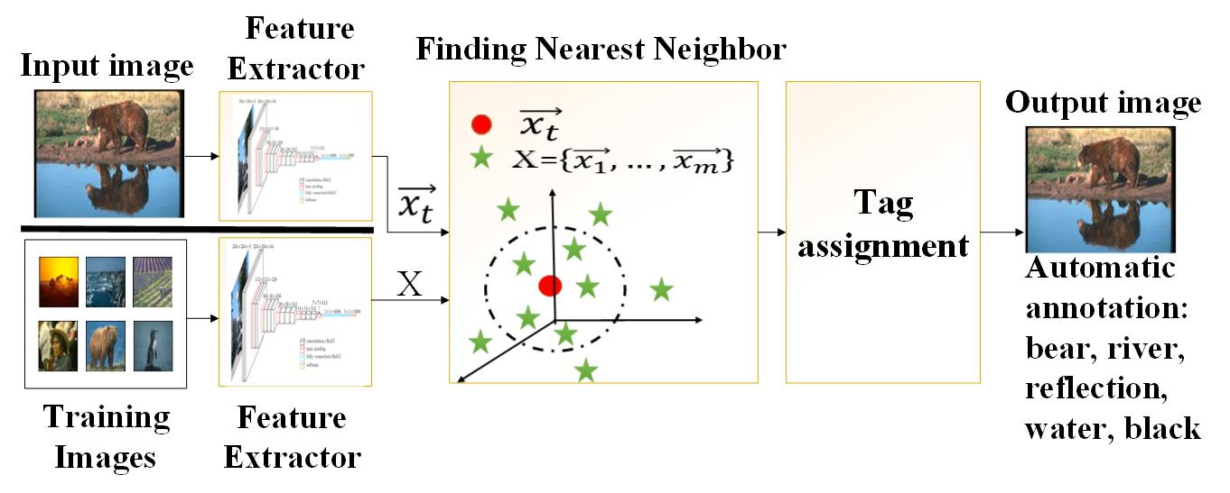
Proposed Method
2017 Artificial Intelligence and Signal Processing Conference (AISP)
Introduction
AIA approaches
Conclusion
References
Proposed Method
Experiments
Fig2. Flow diagram of proposed method

Slide 6
Tag Assignment Section
2017 Artificial Intelligence and Signal Processing Conference (AISP)
Introduction
AIA approaches
Conclusion
References
Proposed Method
Experiments
Tag Assignment
Computing pairwise distances
Extracting similar images
Computing tags similarities
Extracting relevant tags

Slide 7
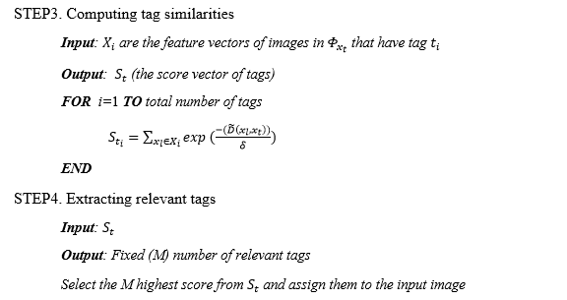
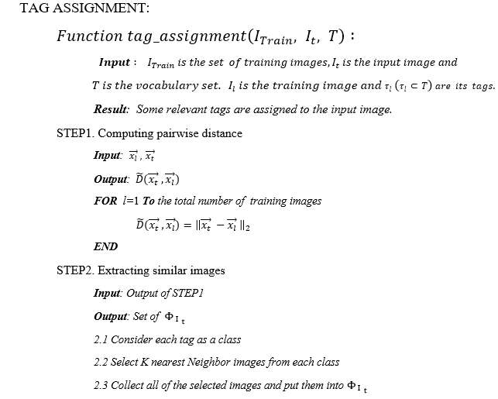
Tag Assignment Section
2017 Artificial Intelligence and Signal Processing Conference (AISP)
Introduction
AIA approaches
Conclusion
References
Proposed Method
Experiments

Slide 8

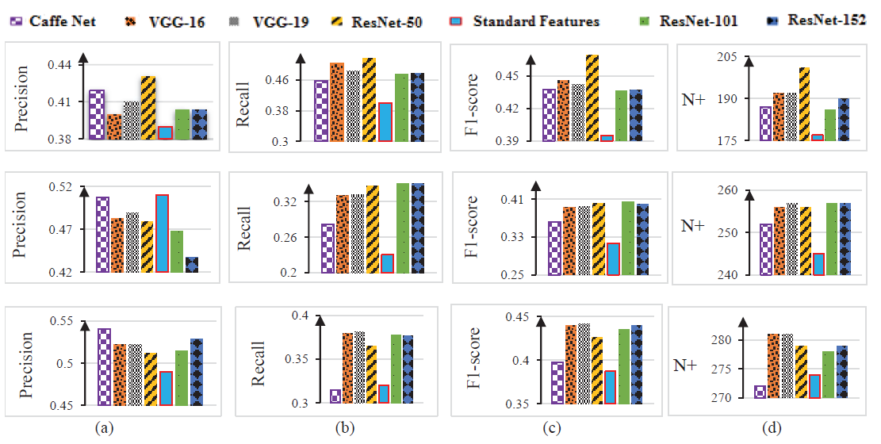
Experiments
2017 Artificial Intelligence and Signal Processing Conference (AISP)
Introduction
AIA approaches
Conclusion
References
Proposed Method
Experiments
Figure3. Annotation performance in terms of mean precision (a), mean recall (b) , F1 score (c) and recall value >0 (d) for different CNN features. Each row of plots is dedicated certain database. The first one is Corel5k, second is ESP Game and the last one is IAPRTC12.

Slide 9

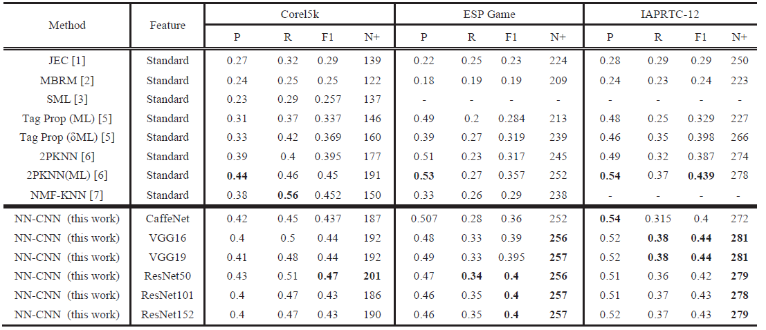
Experiments
2017 Artificial Intelligence and Signal Processing Conference (AISP)
Introduction
AIA approaches
Conclusion
References
Proposed Method
Experiments
25.92%
12.04%
1.98%
2.7%
4%
5.23%
1.07%
Table 1. Experimental results of our proposed models (NN-CNN) against previously reported best scores on the datasets.

Slide 10
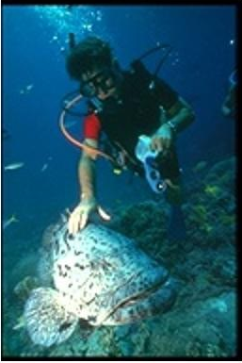
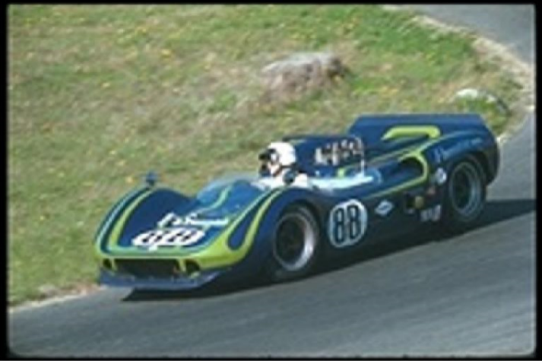
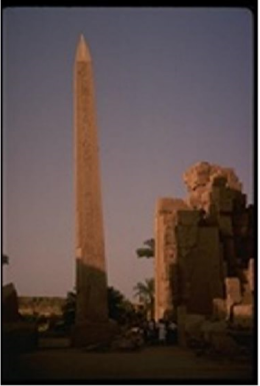
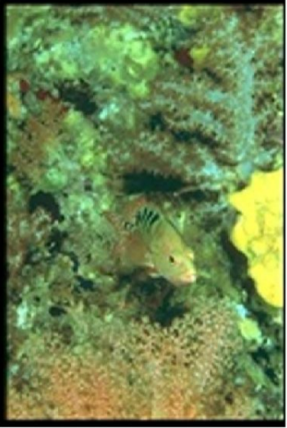
Predicted tags for images of Corel5k Dataset
2017 Artificial Intelligence and Signal Processing Conference (AISP)
Introduction
AIA approaches
Conclusion
References
Proposed Method
Experiments
Predicted tags:
People, ocean, fish, coral, reefs
Predicted tags:
Grass, car, turn, tracks, prototype
Predicted tags:
Bush, landscape, mountain, sky, tree
Predicted tags:
Coral, anemone, fish, ocean, reefs

Slide 11
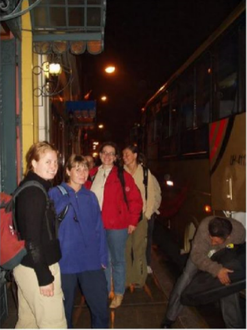
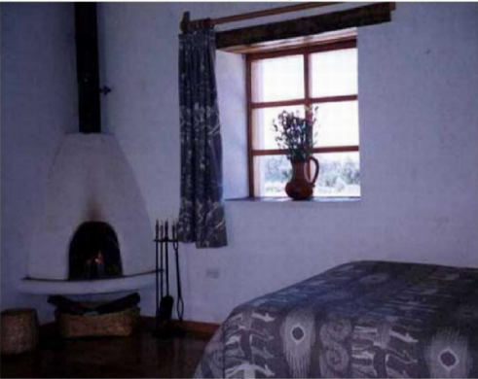
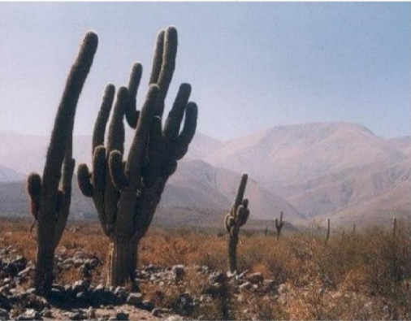
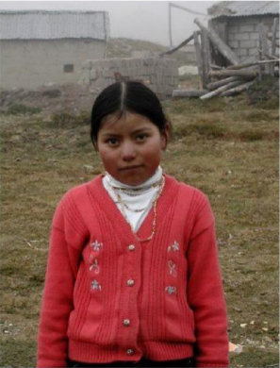
Predicted tags for images of IAPR-TC12 Dataset
2017 Artificial Intelligence and Signal Processing Conference (AISP)
Introduction
AIA approaches
Conclusion
References
Proposed Method
Experiments
Predicted tags:
Front, luggage, man, paving, tourist
Predicted tags:
Bed, bedcover, bedside, curtain, room
Predicted tags:
Bush, landscape, mountain, sky, tree
Predicted tags:
Girl, house, pullover, terrain, waistcoat

Slide 12

Conclusion
2017 Artificial Intelligence and Signal Processing Conference (AISP)
Introduction
AIA approaches
Conclusion
References
Proposed Method
Experiments
Goal of AIA
Organize large number of images and search them more efficiently
For achieving good performance
Using rich representation for visual contents of images
Extracting feature by CNN models
Advantage of proposed method: Using single feature vector, So do not require to use complex approaches (such as metric learning)
Future Works: scalability for large Datasets and reaching more accurate tags

Slide 13
References
2017 Artificial Intelligence and Signal Processing Conference (AISP)
Introduction
AIA approaches
Conclusion
References
Proposed Method
Experiments
[1] Lavrenko, Victor, R. Manmatha, and Jiwoon Jeon. "A model for learning the semantics of pictures." Advances in neural information processing systems. 2004.
[2] Y. Verma and C. Jawahar, " Image Annotation by Propagating Labels from Semantic Neighborhoods," in European Conference on Computer Vision, 2016, pp. 836-849.
[3] He, Kaiming, et al. "Deep residual learning for image recognition." Proceedings of the IEEE conference on computer vision and pattern recognition. 2016.
[4] Krizhevsky, Alex, Ilya Sutskever, and Geoffrey E. Hinton. "Imagenet classification with deep convolutional neural networks." Advances in neural information processing systems. 2012.
[5] Simonyan, Karen, and Andrew Zisserman. "Very deep convolutional networks for large-scale image recognition." arXiv preprint arXiv:1409.1556 (2014).
[6] Guillaumin, Matthieu, et al. "Tagprop: Discriminative metric learning in nearest neighbor models for image auto-annotation." Computer Vision, 2009 IEEE 12th International Conference on. IEEE, 2009.
[7] S. H. Amiri, "Image annotation using semi supervised learning“, PhD Thesis, Computer Engineering, Sharif University of Technology , Iran, Tehran, 2009-2015.
[8] Makadia, Ameesh, Vladimir Pavlovic, and Sanjiv Kumar. "A new baseline for image annotation." Computer Vision–ECCV 2008 (2008): 316-329.

Slide 14

Thank You ☺ Any Question?
2017 Artificial Intelligence and Signal Processing Conference (AISP)

